Slide 1
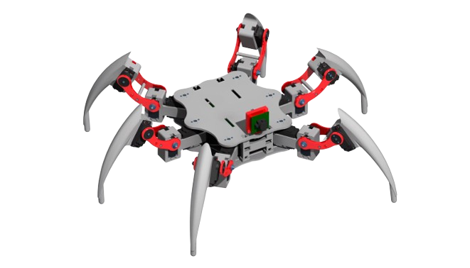

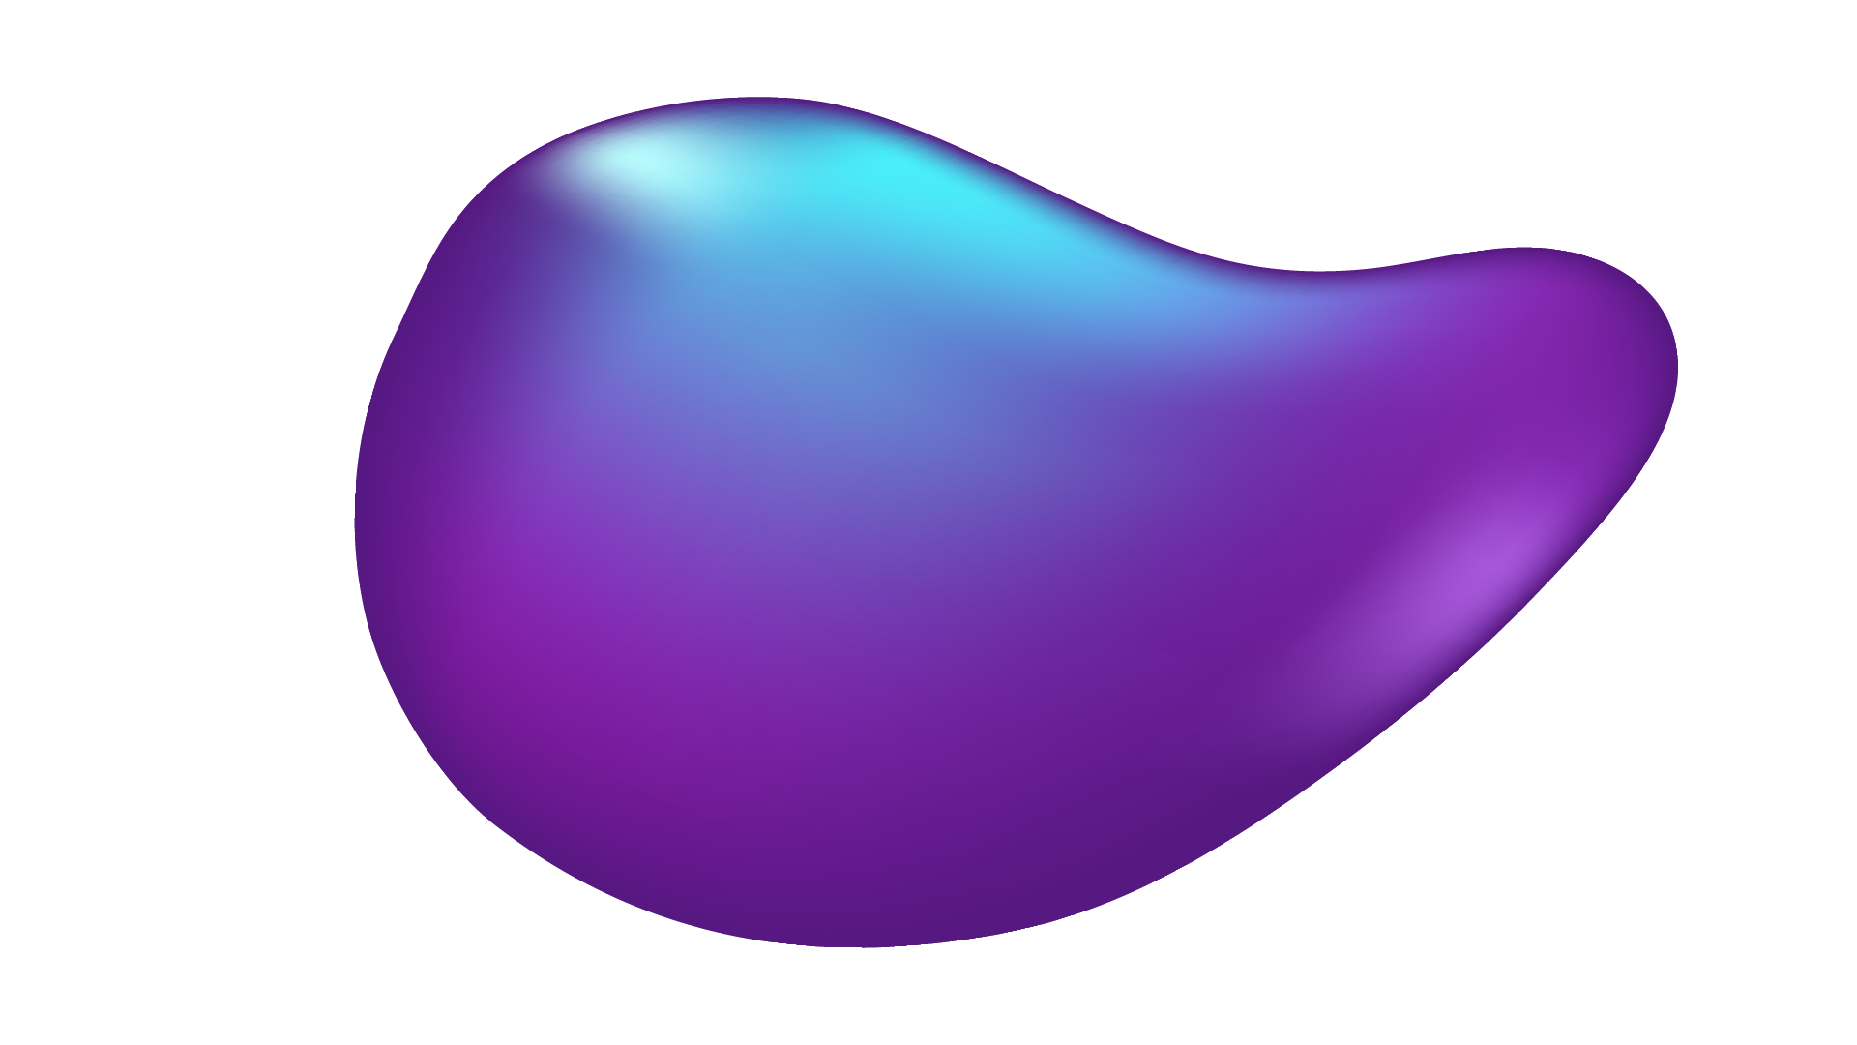
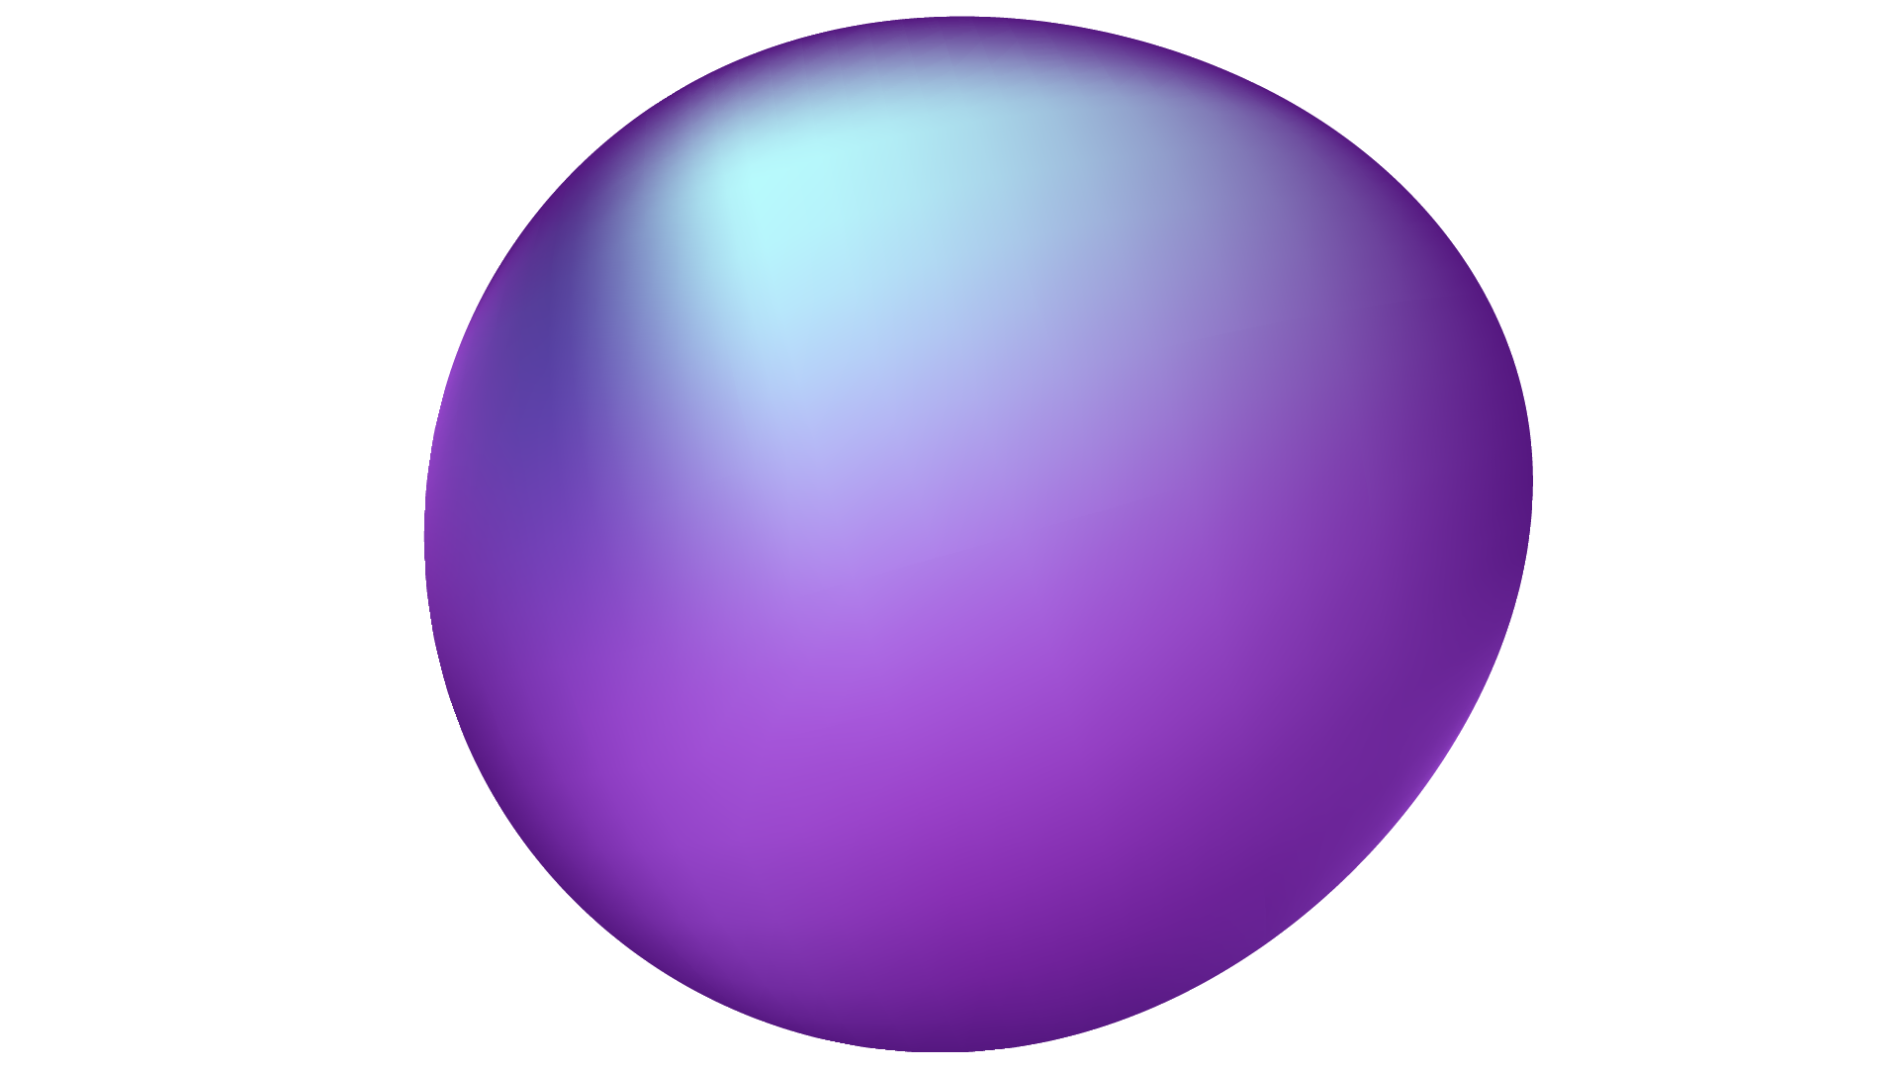

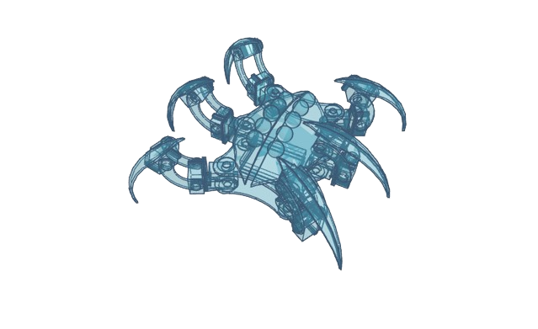
Movement Fault Detection in legged robots with AI

Slide 2
TABLE OF CONTENTS
01
02
03
04
07
About The project
Motivation
How to solve this problem
Optimization process
05
Try to run model on simulator
06
Research Papers
About Us

Slide 3

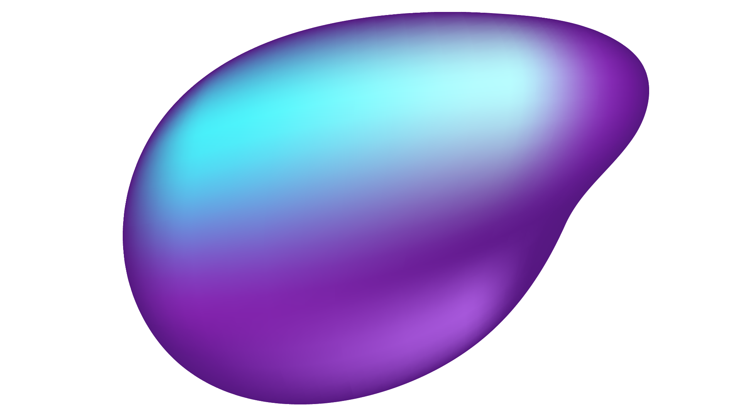
01
ABOUT THE PROJECT

Slide 4
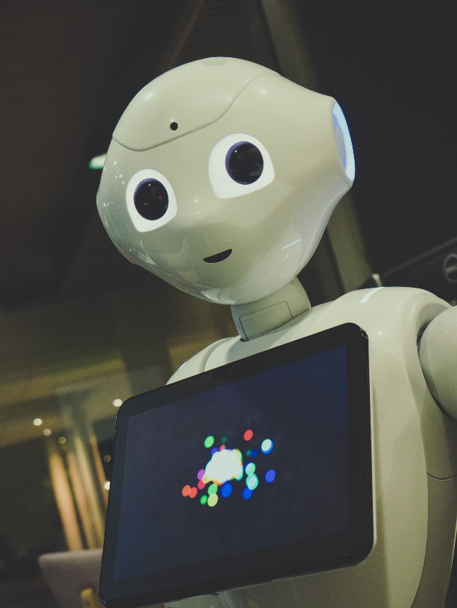
Robots : Robots are programmable machines designed to carry out tasks automatically, often with precision and efficiency.
Purpose: Robots are used in various industries and applications to perform tasks that are dull, dirty, dangerous, or repetitive for humans.
Speaker : Osama

Slide 5
Advantages:
Increased productivity and efficiency.
Improved safety by handling hazardous tasks.
Precision and accuracy in execution.
Ability to work in extreme environments.
Speaker : Osama

Slide 6
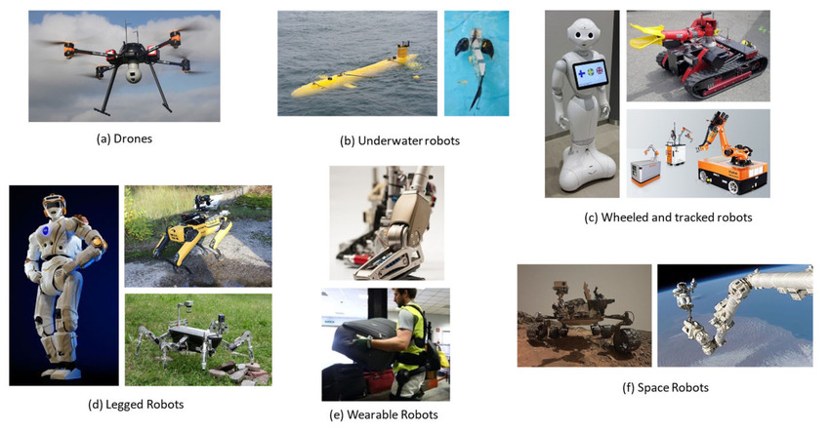
Speaker : Osama

Slide 7
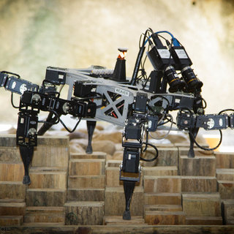
Why Hexa robots ?
1. Stability
2. Mobility and Adaptability
3. Payload capacity
4. Redundancy
Speaker : Osama

Slide 8
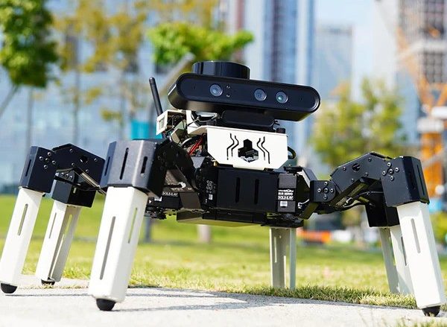
Some Hexapods products from NVIDIA
Contains 18PCS 35KG metal bus servos, depth camera, lidar, voice interaction module, large-capacity batteries and other high-quality accessories.
Using Python3 programming, ROS2 operating systemand inverse kinematics algorithm to accurately control robot movement.
Supports RVIZ simulation, users can control robots and verify algorithms in the virtual environment.
Speaker : Osama

Slide 9
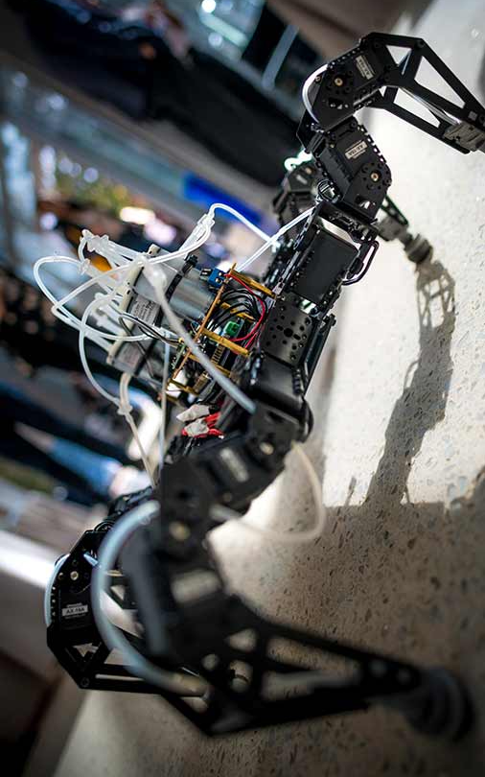
One of the biggest problems facing legged robots is the failure of one of the leg motors.
Many legged robots are lost due to a malfunction that occurred in one of their legs and the inability of the robot to walk correctly and reach the places it is supposed to reach.
These robots are usually expensive.
Speaker : Osama

Slide 10
1. The goal of our project is to try to discover broken motors using artificial intelligence and try to address their steps
2. The project aims to save resources and the expected cost of building a legged robot in order to help spread legged robots and help prevent the loss of broken robots
Speaker : Osama

Slide 11
02 Motivation

Slide 12
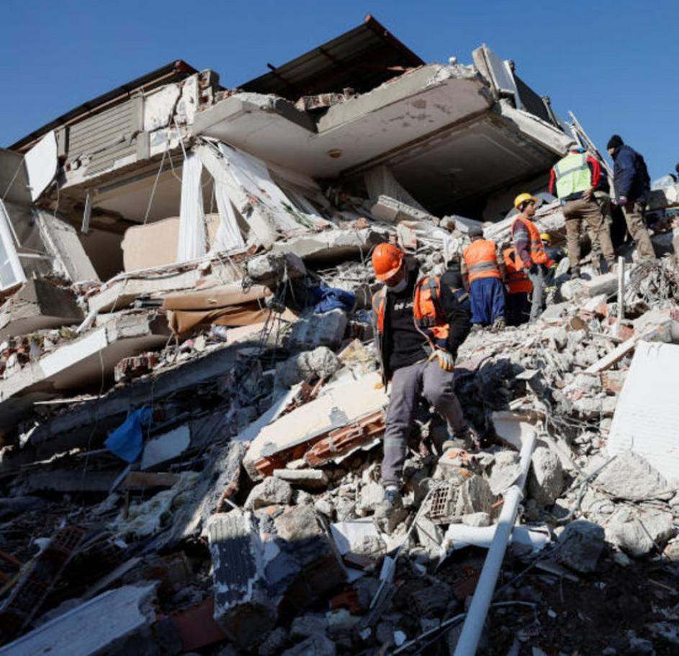
This world has become more difficult than expected.
Full of problems, natural disasters and accidents.
The available natural resources are becoming fewer and our numbers continue to increase.
Speaker : Osama

Slide 13
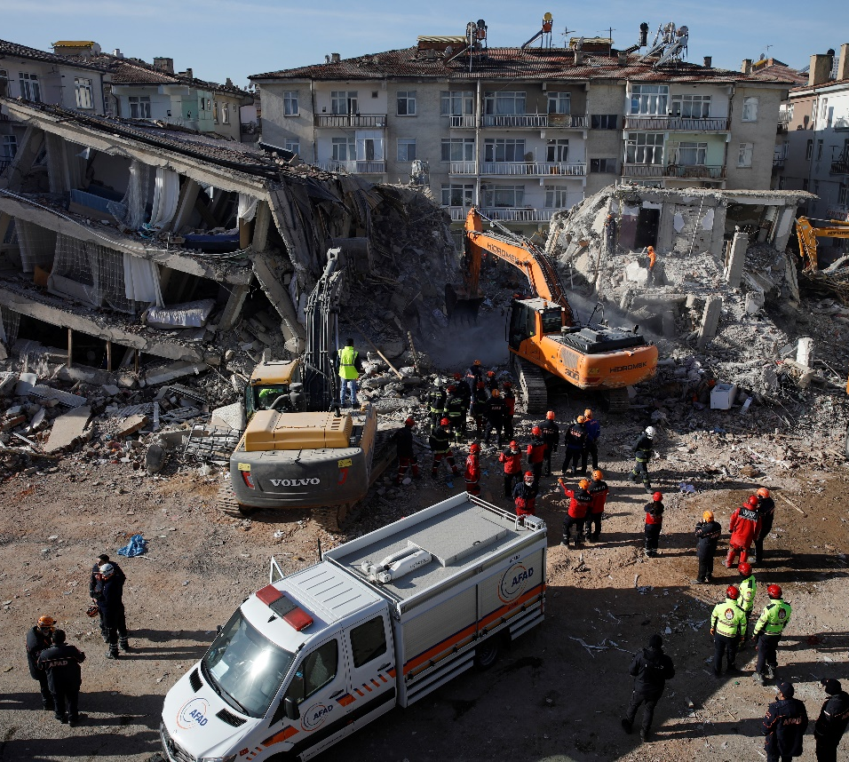
Recently, with the increase in earthquakes and natural disasters, and with the human ambition to explore space.
the use of legged robots has become a necessity in addition to the wheeled theory, due to their ability to reach places that are difficult to reach with wheels.
Speaker : Osama

Slide 14
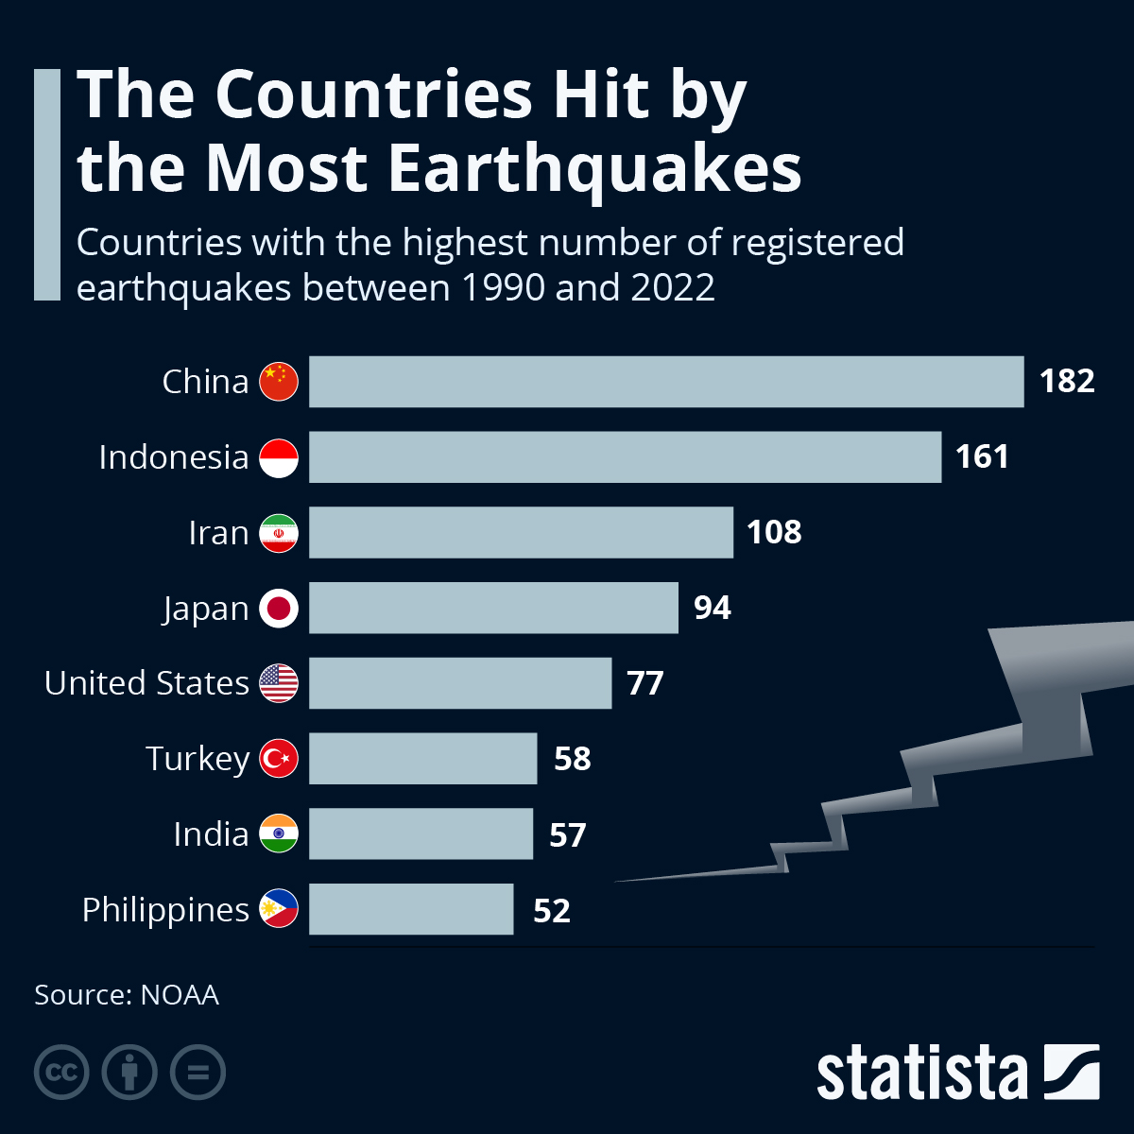
Speaker : Osama

Slide 15
Gait Generation for Damaged Hexapods using a Genetic Algorithm Paper (6) “IEEE Xplore, June. 04, 2020
Genetic Algorithm Paper | Our Project
Used Evolutionary Algorithms such as Genetic Algorithm ( GA ) | we use AI classification models such as . Decision Tree , Random Forest , Support Vector Machine, Logistic Regression,…etc.
Used Gazebo simulator | we used Webots simulator , this simulator is free and open source
In this paper for improving the algorithm, increasing number of generations , in training the best number of generations is 200 and take 20 hours | For improving our model by selecting the best classification models for this idea , and tunning hyper parameters of each classification model.
Speaker : Osama

Slide 16
03 How we solve it

Slide 17
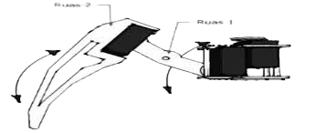
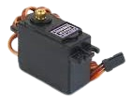
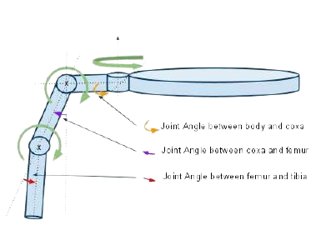
Hexapod structure :
18 degrees of freedom because it has 6 legs and each leg has 3 joints.
The joint is a servo motor
The Kinematics of the leg of hexapod robot
Speaker : Mostafa

Slide 18
collecting the Data :
Searching for a good simulator
This research paper on WEBOTS simulator (1:4)
Webots the windows operating system and has the structure of the hexapod and its smooth movements
Our data is 965 X, Y, and Z values.
Doing Feature engineering adding, multiplying, dividing or taking the difference between the current value and the previous value
Speaker : Mostafa

Slide 19
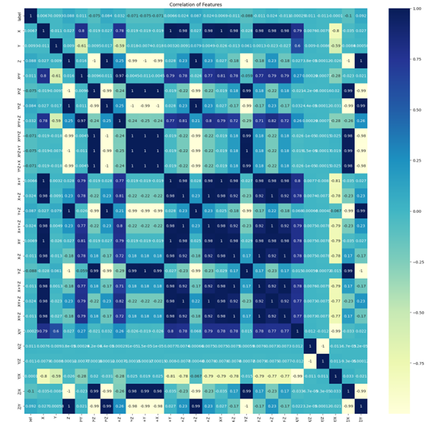
Speaker : Mostafa

Slide 20
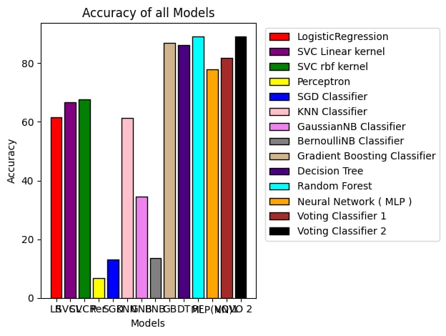
The chart of the accuracy for all models”
Speaker : Mostafa

Slide 21
model training and it`s performance
After training some machine learning models on 21 features, the gotten accuracy :
Random Forest (n_estimators=200,max_depth=900): | 89.073569 %
Gradient Boosting Classifier (LR=0.5) | 86.730245 %
Neural Network ( MLP ) : | 79.782016 %
SVC Linear kernel (10000 iter , degree = 3) | 66.594005 %
Logistic Regression(max_iter =10000) | 61.580381 %
KNN Classifier (n_neighbors =5) | 61.226158 %
SGD Classifier (10000 iter) | 16.730245 %
Speaker : Mostafa

Slide 22
Feature Reduction
Speaker : Mostafa

Slide 23
scaling the number of features
Trying to use PCA, and pass it`s output into the model ,the gotten accuracy
- Neural Network ( MLP ): 75.068120 %
- SVC Linear kernel (10000 iter , degree = 3) : 66.457766 %
- Random Forest (n_estimators =200,max_depth=900) : 58.828338 %
- Logistic Regression(max_iter=10000) : 57.847411 %
- Gradient Boosting Classifier (LR=0.5) : 52.425068 %
- KNN Classifier (n_neighbors=5): 52.152589%
- GaussianNB Classifier: 26.430518%
- SGD Classifier (max_iter=10000) : 17.057221%
Speaker : Mostafa

Slide 24
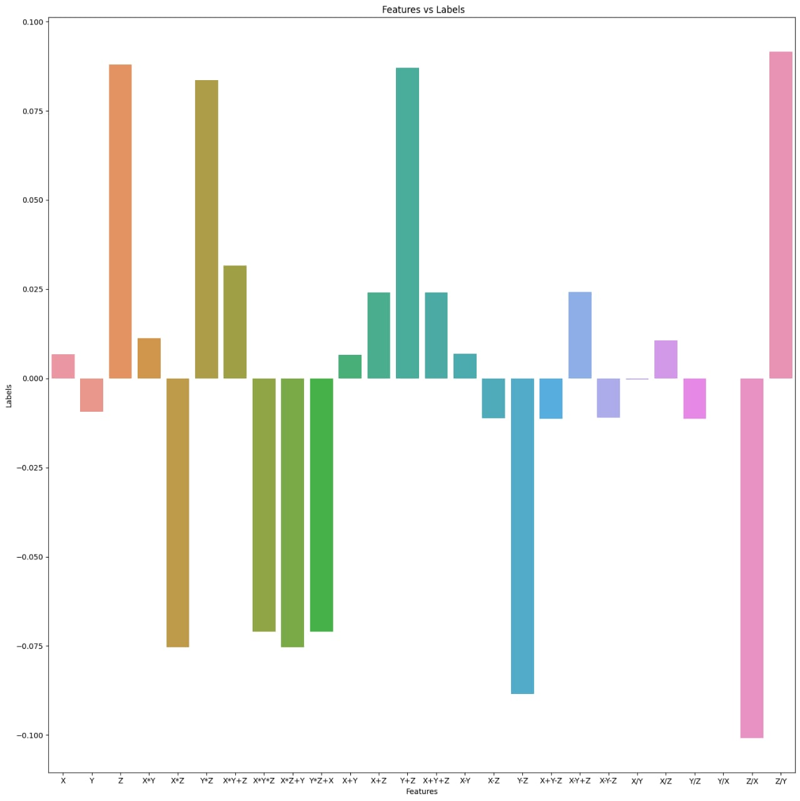
Features correlations with label
Filter auto features with low correlations with the Labels feature:
X+Y , X-Y-Z , X/Y , X/Z , Y/Z , Y/X , Z/Y , Z/X , Y-Z
Took the highest five features correlated with the label feature and the highest performance of the models is 85.722%
Speaker : Mostafa

Slide 25
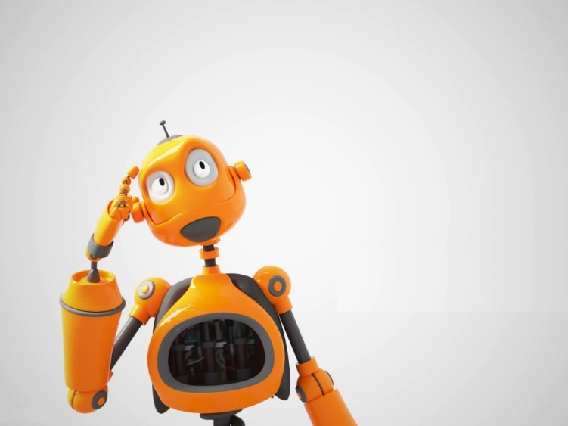
What about Different Sampling Rate?

Slide 26
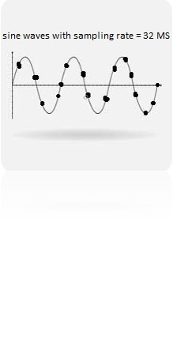
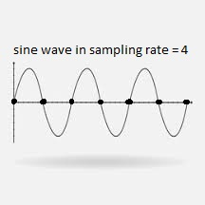
In the sampling rate = 32 MicroSecond and in the movement code of the hexapod it use sin and by looking on localization values it take it in random points
In the sampling rate = 4 Second By taking values over a specific time cycle (the time it takes for a specific leg in the robot to touch the ground again)
Then we read one value every time that sin be zero
Speaker : Joeschowa

Slide 27
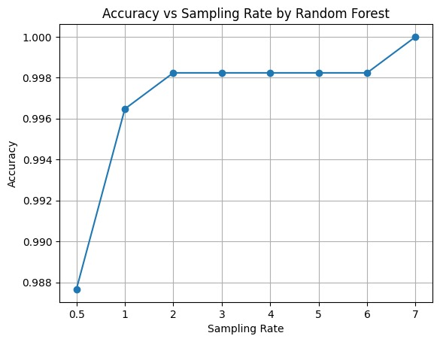
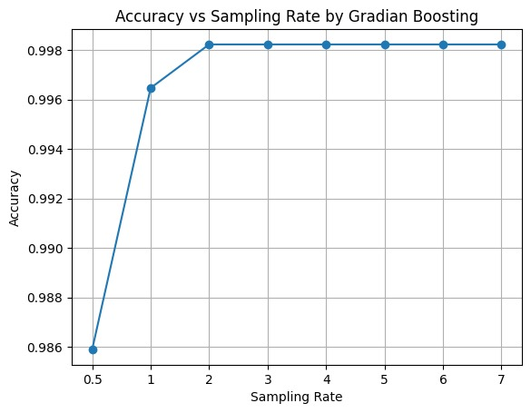
The accuracy of Different Sampling Rate?

Slide 28
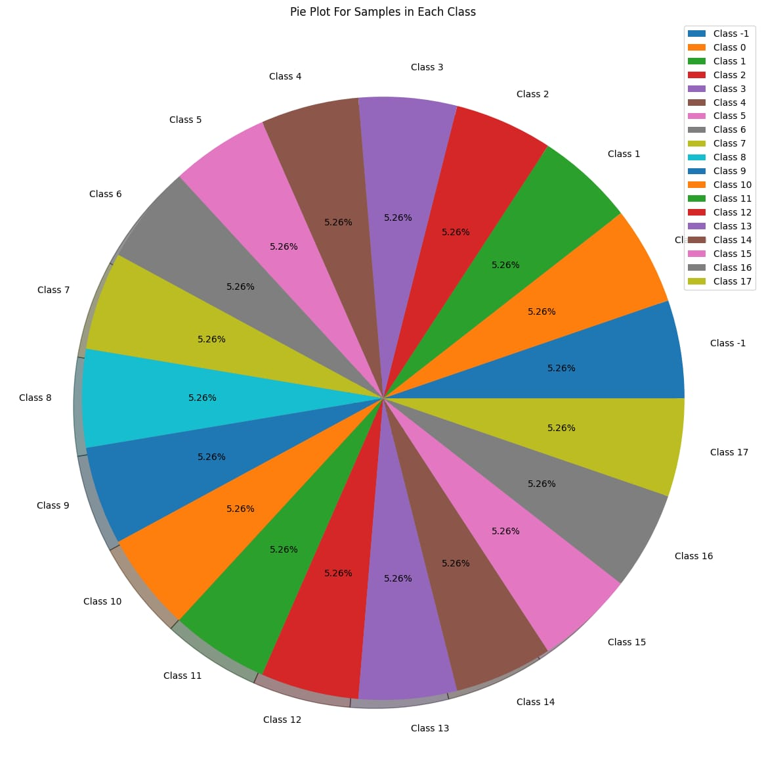
Balanced data
After 63 minutes, collected 944 X, Y, and Z values. Every time by separating one of the joints and add the values of X, Y, and Z, doing this process until the last joint . The length of dataset that we have 17956 rows in 39 columns
Speaker : Joeschowa

Slide 29
scaling the number of features
Trying to use an feature scaling algorithms better than PCA like recursive feature elimination (RFE) , multidimensional scaling (MDS) and T-SNE scaling
The More convenient one to our data is RFE Which scale the features from 39 into 5 features with high accuracy
from this features ' X ' , ' Z/Y ' , ' slop(x) ' , ' slop(x/z) ' , 'slop(z)’
The gotten accuracy from this ML models is :
-Gradient Boosting Classifier (LR=0.5) : 99.8049052396%
-Random Forest (n_estimators =200,max_depth=900) :99.777034559%
-Support vector machine(SVM) (10000 iter , degree = 3) : 92.78149386%
3. 4.
Speaker : Joeschowa

Slide 30
comparing Random Forest and Gradient Boosting
In summary, if interpretability and training speed are important considerations, Random Forest may be preferred. However, if achieving the highest accuracy
is crucial and computational resources are sufficient.
 | Random Forest (tree data structure) | Gradient Boosting
Complexity | while Random Forest builds independent trees and combines their predictions | Gradient Boosting is more complex as it builds trees sequentially to correct errors
Performance | Both models offer high accuracy | Both models offer high accuracy
Training and Inference Speed | Random Forest generally trains faster than Gradient Boosting, especially with large datasets | although Gradient Boosting can be faster during inference
Speaker : Joeschowa

Slide 31
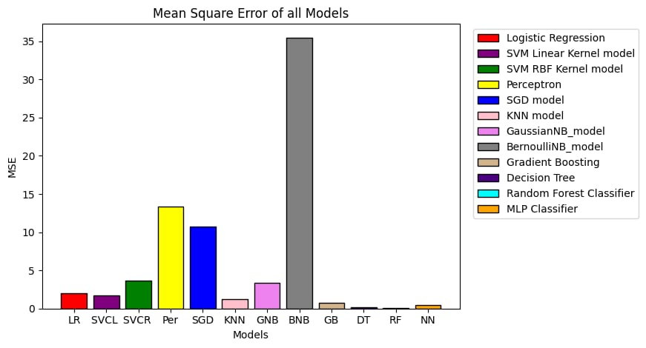

Slide 32
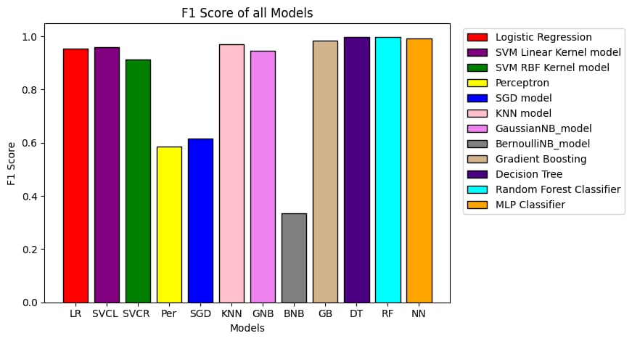
Random Forest confusion matrix

Slide 33
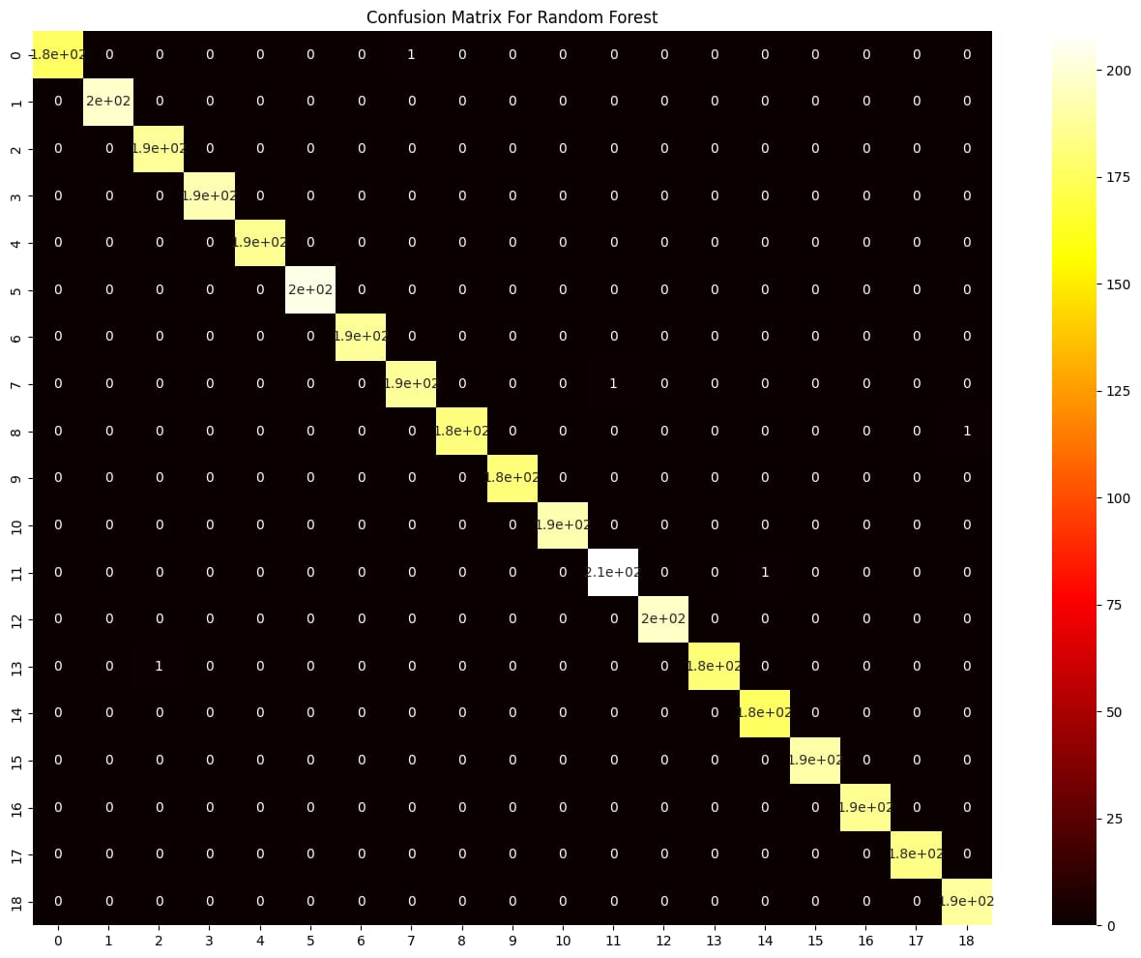
Random Forest
confusion matrix

Slide 34
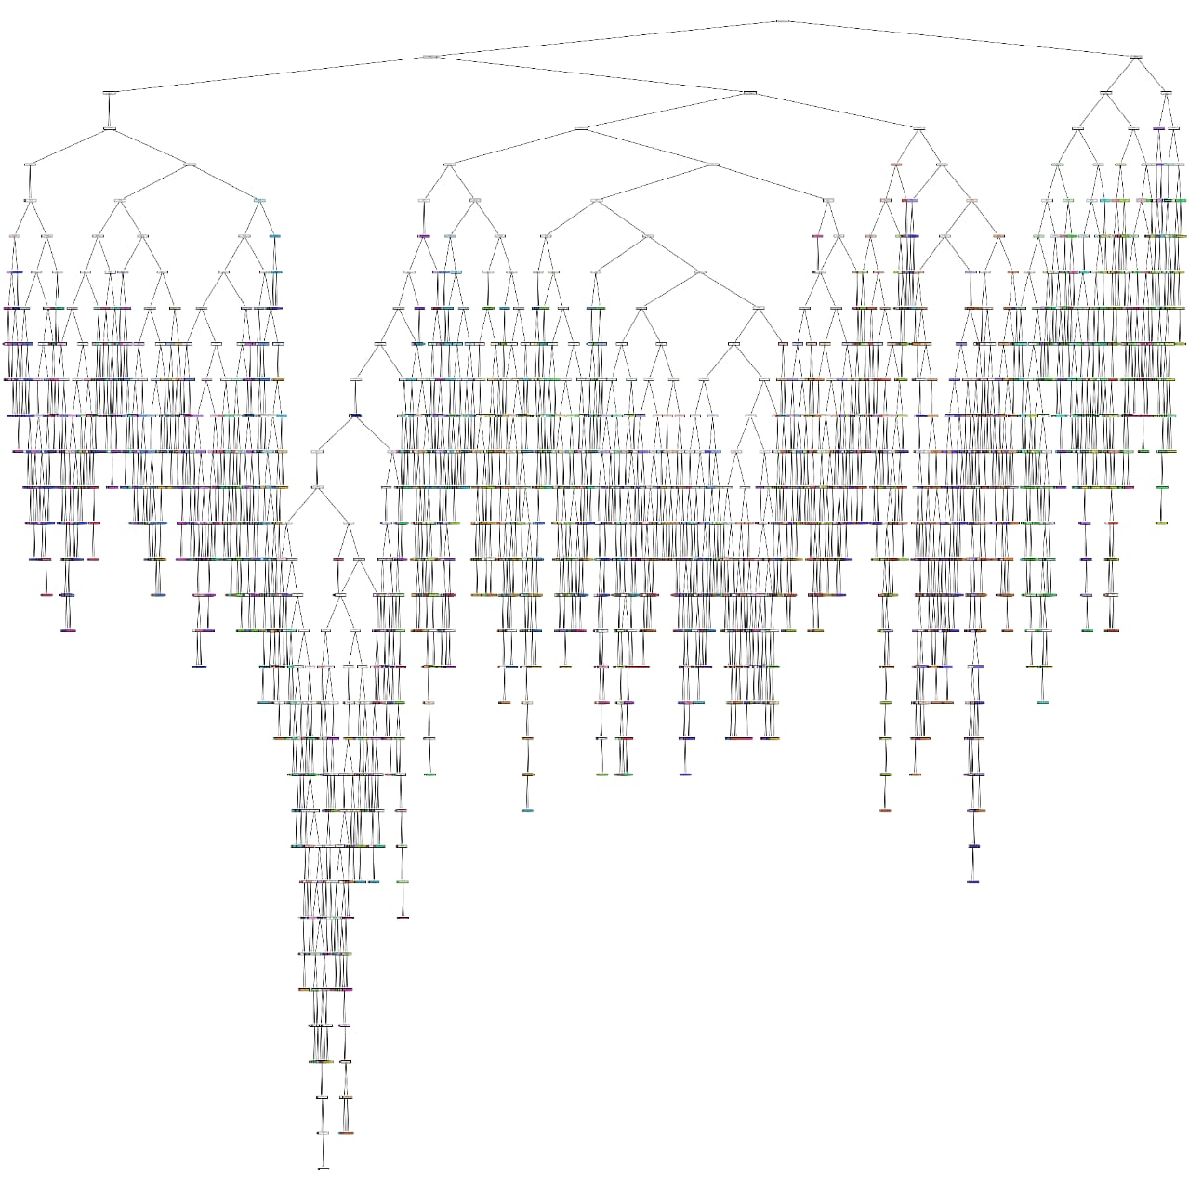
Random Forest
structure

Slide 35

KNN confusion matrix
Speaker : Joeschowa

Slide 36
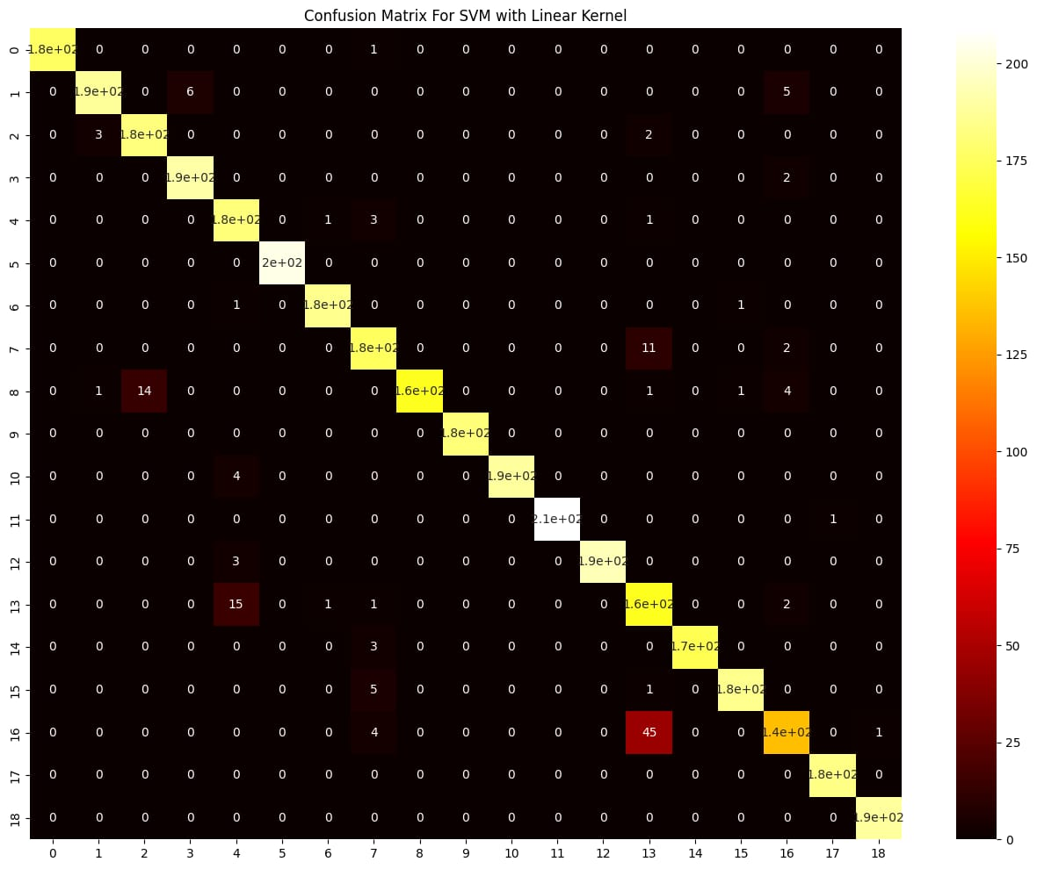
SVM confusion matrix
Speaker : Joeschowa

Slide 37

Gaussian NB
confusion matrix

Slide 38
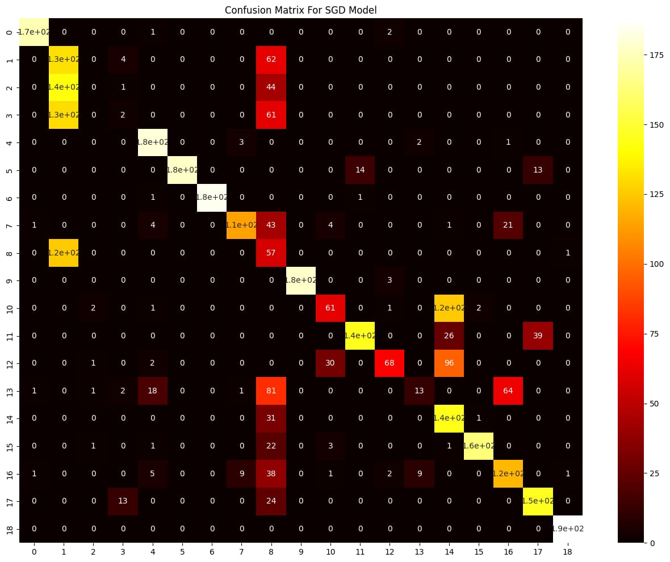
Stochastic gradient descent (SDG) confusion matrix

Slide 39
04
Optimization of One Joint Code
Speaker : Sameh

Slide 40
All Integer Features
Using all integer features with a model configured with max_depth=8 and n_estimators=3, we achieved:
Accuracy: 99.03%
Memory Usage: 69.46 KB
Speaker : Sameh

Slide 41
Selected Integer Features
Using selected integer features such as 'X', 'Y', 'Z', 'X*Y', 'X*Z', 'Y*Z', 'X*Y+Z', 'X*Y*Z', 'X*Z+Y', 'Y*Z+X','X+Y', 'X+Z', 'Y+Z', 'X+Y+Z', 'X-Y',
'X-Z', 'Y-Z', 'X+Y-Z', 'X-Y+Z',’X-Y-Z', 'X/Y', 'X/Z', 'Y/Z', 'Y/X', 'Z/X', 'Z/Y', 'slop(x)' with a more complex model configured with max_depth=17 and n_estimators=3, we achieved:
Accuracy: 97.99%
Memory Usage: 530.69 KB
Speaker : Sameh

Slide 42
Additional Integer Features
Using a different set of integer features with a model configured with max_depth=8 and n_estimators=3, we achieved:
Accuracy: 97.80%
Memory Usage: 70.99 KB
Speaker : Sameh

Slide 43
Further Integer Feature Combinations
Using another combination of integer features with varying model parameters, we obtained the following results:
Model with n_estimators=5:
Accuracy: 97.05%
Memory Usage: 166.71 KB
Model with n_estimators=6:
Accuracy: 98.25%
Memory Usage: 199.39 KB
Model with max_depth=10, n_estimators=5:
Accuracy: 98.25%
Memory Usage: 275.31 KB
Speaker : Sameh

Slide 44
Specific Integer Features
Using specific integer features with a model configured with max_depth=10 and n_estimators=5, we achieved:
Accuracy: 97.97%
Memory Usage: 219.09 KB
Speaker : Sameh

Slide 45
Float Features
Using all Float Features
Model with max_depth=9, n_estimators=1:
Accuracy: 96.91%
Memory Usage: 19.48 KB
Model with max_depth=9, n_estimators=2:
Accuracy: 99.58%
Memory Usage: 37.19 KB
Model with max_depth=11, n_estimators=4:
Accuracy: 99.58%
Memory Usage: 90.90 KB
Model with max_depth=7, n_estimators=2:
Accuracy: 97.86%
Memory Usage: 27.62 KB
Speaker : Sameh

Slide 46
Optimization of two Joint Code
Speaker : Sameh

Slide 47
All Integer Features
Using all integer features with a model configured with max_depth=12 and n_estimators=4, we achieved
Accuracy: 91.10%
Memory Usage: 5.00 MB
Speaker : Sameh

Slide 48
Selected Integer Features
Using selected integer features such as 'X', 'Y', 'Z', 'X*Y', 'X*Z', 'Y*Z', 'X*Y+Z', 'X*Y*Z', 'X*Z+Y', 'Y*Z+X','X+Y', 'X+Z', 'Y+Z', 'X+Y+Z', 'X-Y', 'X-Z', 'Y-Z', 'X+Y-Z', 'X-Y+Z',’X-Y-Z', 'X/Y', 'X/Z', 'Y/Z', 'Y/X', 'Z/X', 'Z/Y', 'slop(x)' with a more complex model configured with max_depth=13 and n_estimators=20, we achieved:
Accuracy: 74.33%
Memory Usage: 48.39 MB
Speaker : Sameh

Slide 49
Additional Integer Features
Using another set of integer features with a model configured with max_depth=13 and n_estimators=6, we achieved:
Accuracy: 90.86%
Memory Usage: 10.78 MB
Speaker : Sameh

Slide 50
Further Integer Feature Combinations
Using another combination of integer features with varying model parameters, we obtained the following results:
Model with n_estimators=8:
Accuracy: 72.43%
Memory Usage: 7.28 MB
• Model with n_estimators=6:
o Accuracy: 66.91%
o Memory Usage: 5.71 MB
• Model with n_estimators=5:
o Accuracy: 64.28%
o Memory Usage: 4.85 MB
Speaker : Sameh

Slide 51
Float Features for Two Joints
Float Features
Model with max_depth=14, n_estimators=4:
Accuracy: 97.25%
Memory Usage: 4.496 MB
Model with max_depth=13, n_estimators=4:
Accuracy: 99.58%
Memory Usage: 3.836 MB
Model with max_depth=11, n_estimators=4:
Accuracy: 99.58%
Memory Usage: 2.348 MB
Model with max_depth=12, n_estimators=4:
Accuracy: 97.86%
Memory Usage: 2.845 MB
Speaker : Sameh

Slide 52
Optimization of Number of Classes
- From code of Two Joints we deal with labels as strings such as
‘ 1&2 ’,’ 3&4 ’ , ‘ 1&8 ‘ , and so on , then number of classes is 154 labels
We need to optimize this number of labels
We used this model MultiOutputClassifier , this model is deal with
Multi - labels , this model is good for two joints code
We split the column ‘ Label’ into two columns , first column for
first damaged joint and second for the second damaged joint
Speaker : Sameh

Slide 53
Optimization of Number of Classes
This model helps us for optimizing number of classes , it reduce labels
From 154 labels to 19 labels only .
- Using all float features with a model configured with max_depth=13 and n_estimators=15, we achieved:
Accuracy: 98.86%
Memory Usage: 7.2 MB
- Using all float features with a model configured with max_depth=10 and n_estimators=11, we achieved:
Accuracy: 97.2 %
Memory Usage: 2.6 MB
Speaker : Sameh

Slide 54
05
Try to run model on simulator
Speaker : Joeschowa

Slide 55
Model testing on the simulator
After training and optimizing the model code , trying to test it on the live time
Using AI box to run the model on it and connect it with ESP microcontroller by Wi-Fi to send the reads of the robot
For this short time the model has been testing on the simulator
Speaker : Joeschowa

Slide 56
Model testing on the simulator
First founded that the random forest is overfitting and it is not trainable over time
Used other models like SVC and Gradient Boosting but after 5000 step it overfitting
Use Stochastic gradient descent as optimizer which is training over time to solve overfitting after long time
Speaker : Joeschowa

Slide 57
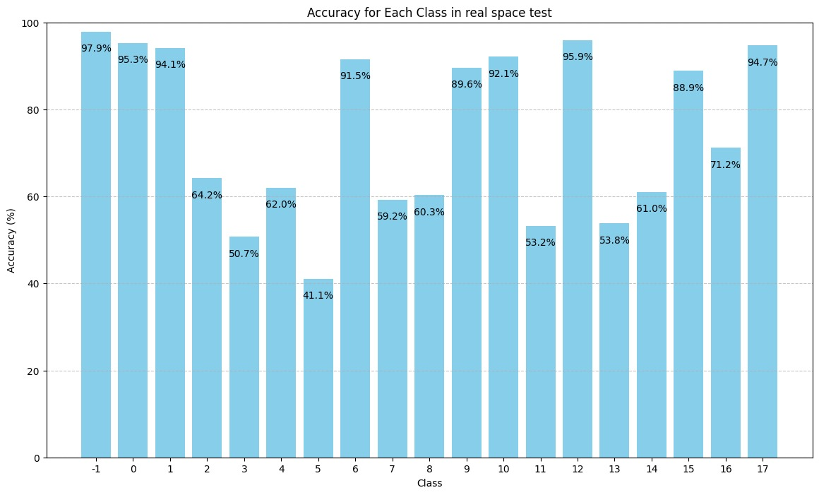
Model testing on the simulator before optimization
This graph explains that Accuracy for detect fault in each motor
best Accuracy : class -1 means all motors working successfully
Worst Accuracy : class 5
Speaker : Joeschowa

Slide 58
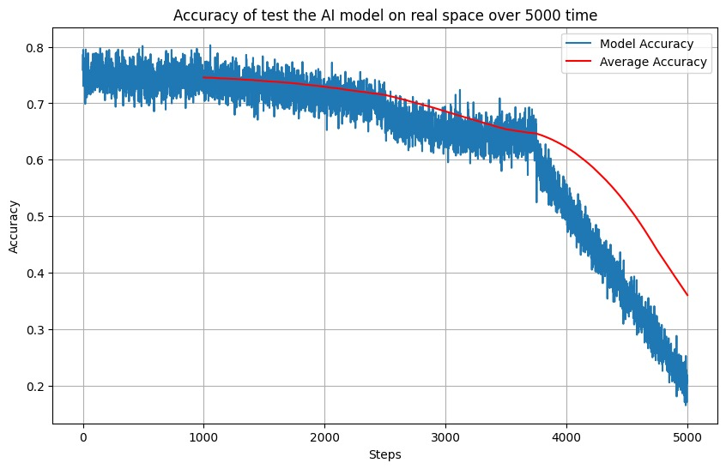
Model testing on the simulator before optimization
This graph explains that Accuracy on real space
Our Model have a problem after 3500 steps
Speaker : Joeschowa

Slide 59
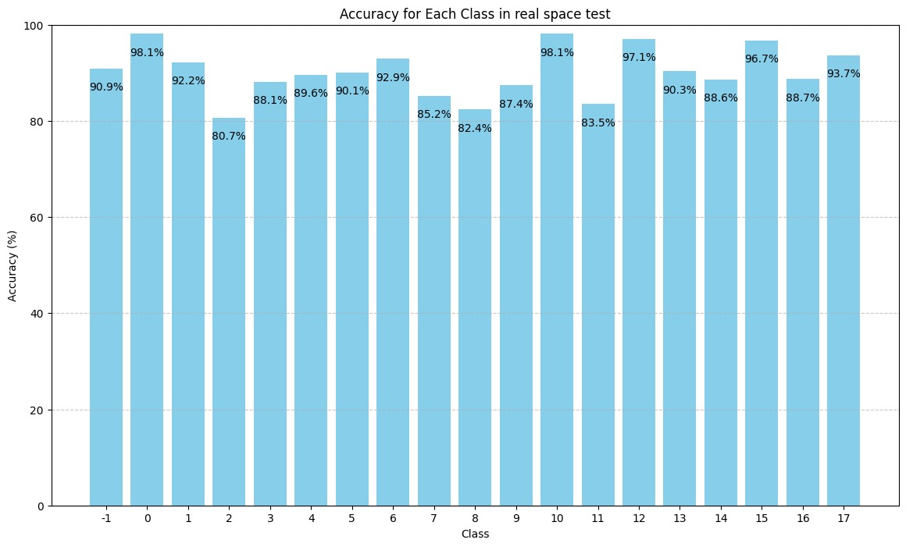
Model testing on the simulator after optimization
This graph explains that Accuracy for detect fault in each motor
Average of all accuracy become better after optimization
Speaker : Joeschowa

Slide 60
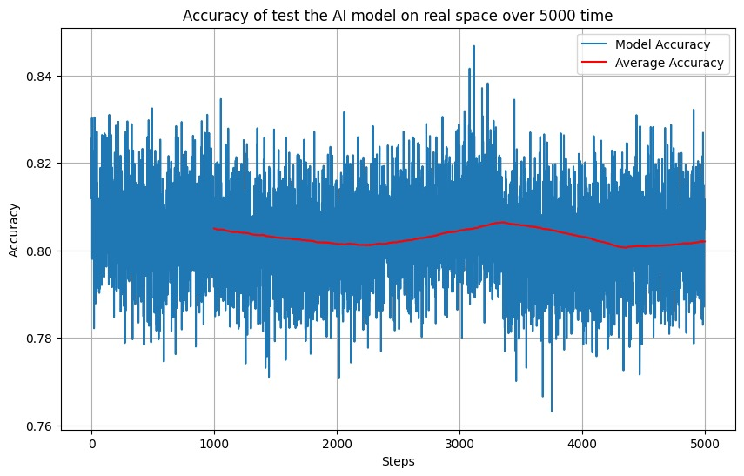
Model testing on the simulator after optimization
This graph explains that Accuracy on real space
Our Model become has more stability in real space after optimization
Speaker : Joeschowa

Slide 61
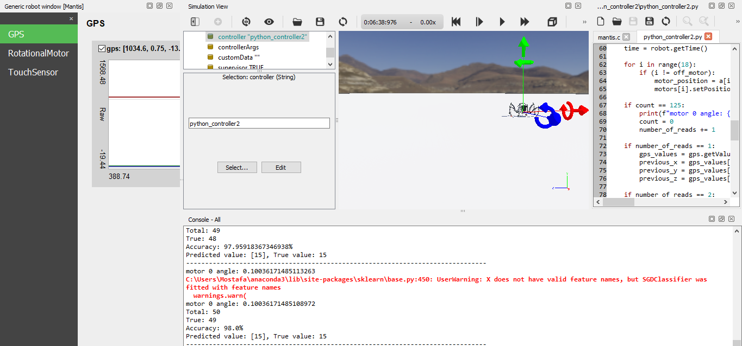
Simulator results
Speaker : Joeschowa

Slide 62
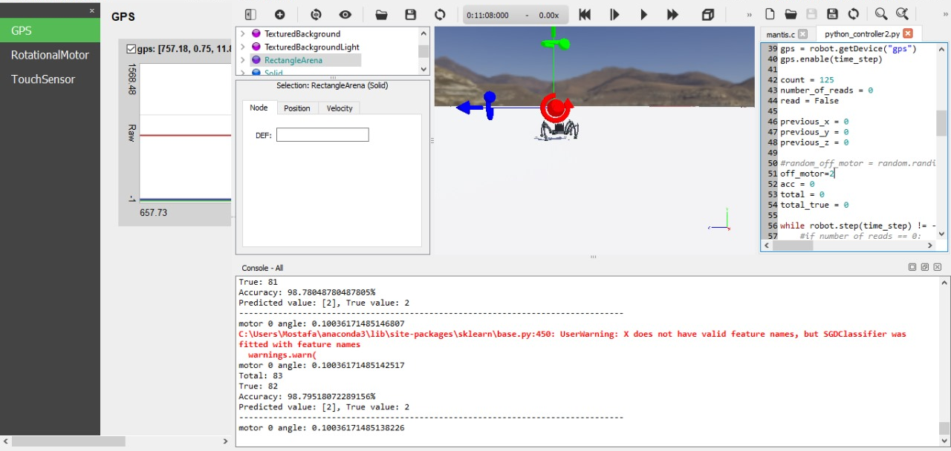
Simulator results
Speaker : Joeschowa

Slide 63
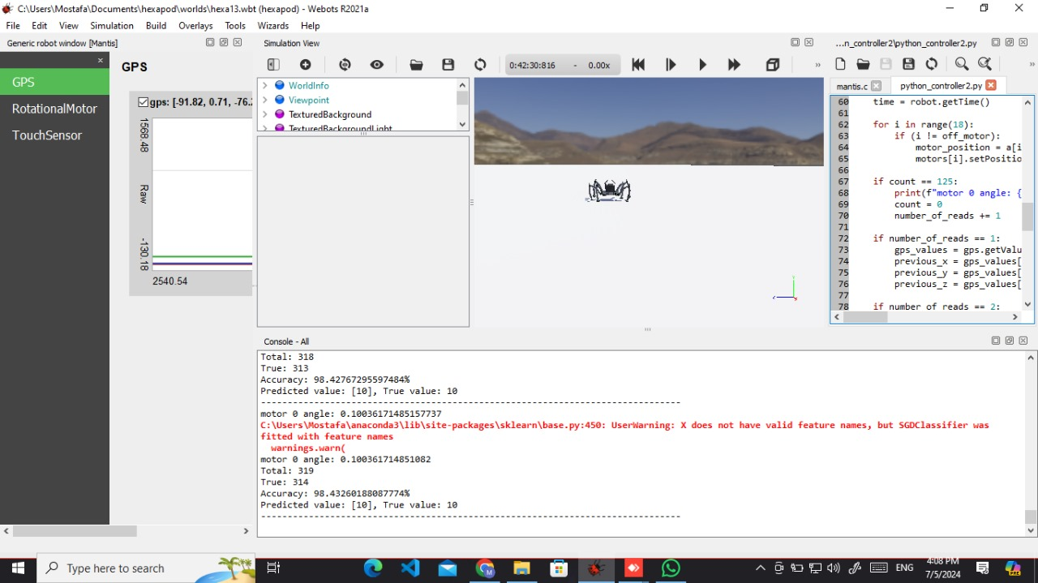
Simulator results
Speaker : Joeschowa

Slide 64
04
Research Papers

Slide 65
D. D. Kulkarni and S. B. Nair, “Transfer Learning for Embodied Neuroevolution,” ResearchGate, Jul. 2023
M. Xu and J. Wang, “Deep Reinforcement Learning for Parameter Tuning of Robot Visual Servoing,” ACM Transactions on Intelligent Systems and Technology, ResearchGate, vol. 14, no. 2, pp. 1–27, Feb. 2023
X. Zou et al…, “NEUROEVOLUTION OF A RECURRENT NEURAL NETWORK FOR SPATIAL AND WORKING MEMORY IN A SIMULATED ROBOTIC ENVIRONMENT A PREPRINT,” IEEE Xplore, 2021.
S. De, Y. Huang, S. Mohamed, D. Goswami, and H. Corporaal, “Hardware- and Situation-Aware Sensing for Robust Closed-Loop Control Systems,” 2021 Design, Automation & Test in Europe Conference & Exhibition (DATE), ResearchGate, Feb. 2021
Speaker : Joeschowa

Slide 66
Chissanupong Saengsint et al… ,“Autonomous Rescue Hexapod Robot with AI Human Detection and Tracking “, IEEE Xplore , December. 22, 2023
J. Dupeyroux, S. Lapalus, I. Brodoline, S. Viollet, and J. R. Serres , “Insect-inspired omnidirectional vision for autonomous localization on-board a hexapod robot,” IEEE Xplore, Sep. 18, 2020.
Justin Kon and Ferat Sahin , “Gait Generation for Damaged Hexapods using a Genetic Algorithm “IEEE Xplore, June. 04, 2020
Hung-Yuan Chung , Yao-Liang Chung and Yi-Jan Hung “An Effective Hexapod Robot Control Design Based on a Fuzzy Neural Network and a Kalman Filter” IEEE Xplore , April. 18 ,2019
Patrik Kutilek et al… , “Control of hexapod with static-stable walking using artificial intelligence “,IEEE Xplore, January. 30, 2017
Speaker : Joeschowa

Slide 67
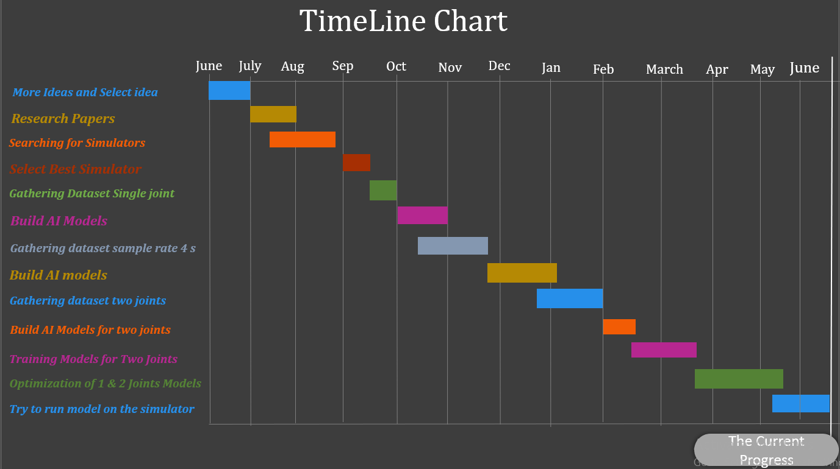
Speaker : Joeschowa

Slide 68



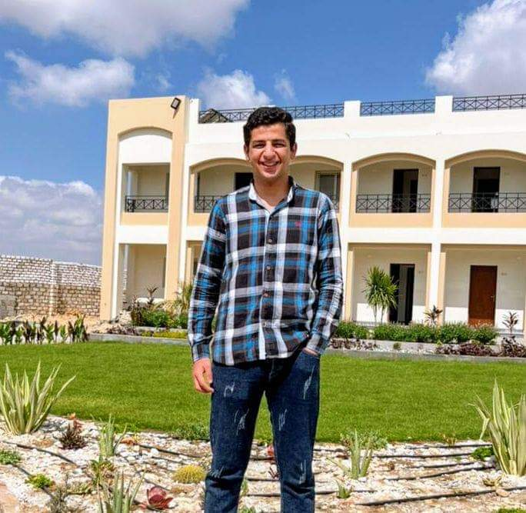
OUR TEAM
Joeshwoa George
Osama Ibrahim Marzok
Sameh Raouf Helmy
Mostafa Mohamed Nabil

Slide 69
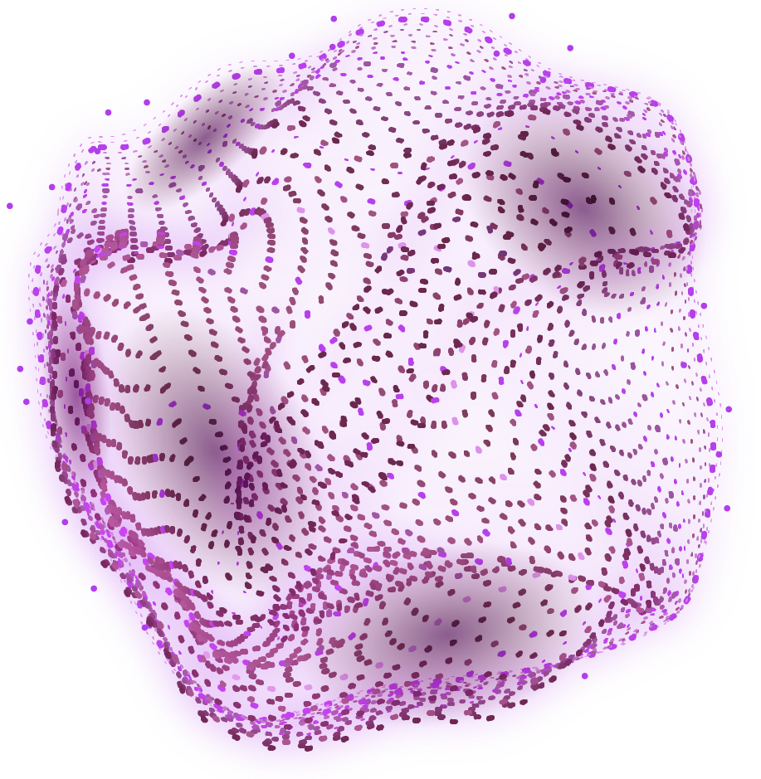
Under supervision : Dr/ Mustafa Shiple

